Slide 1

Pre-Submission Seminar on Employ Interests Survey Form
Presented By
Muskan pethiya
(CS19A55)
Guided By
Ratnesh Choudhary
Department of Computer Science & Engineering
S. B. JAIN INSTITUTE OF TECHNOLOGY MANAGEMENT AND RESEARCH,NAGPUR
An Autonomous Institute, Affiliated to RTMNU, Nagpur
S. B. Jain Institute of Technology Managemen and research

Slide 2
Contents
Introduction
Preview : webpage on employ survey form
System Design
Technology Used
Testing Report :- screenshots
Advantages & Applications
Conclusion
References
S. B. Jain Institute of Technology Management and Research
2

Slide 3
Introduction
An employee survey is defined as a type of survey questionnaire to obtain opinions and reviews and evaluate employee mood and morale, a degree of engagement, and also monitor employee achievements. Generally, employee surveys are used by HR and Management members of an organization and are kept anonymous to motivate the workforce to comment on their good and bad experiences without any hesitation.
S. B. Jain Institute of Technology Management and research
3

Slide 4
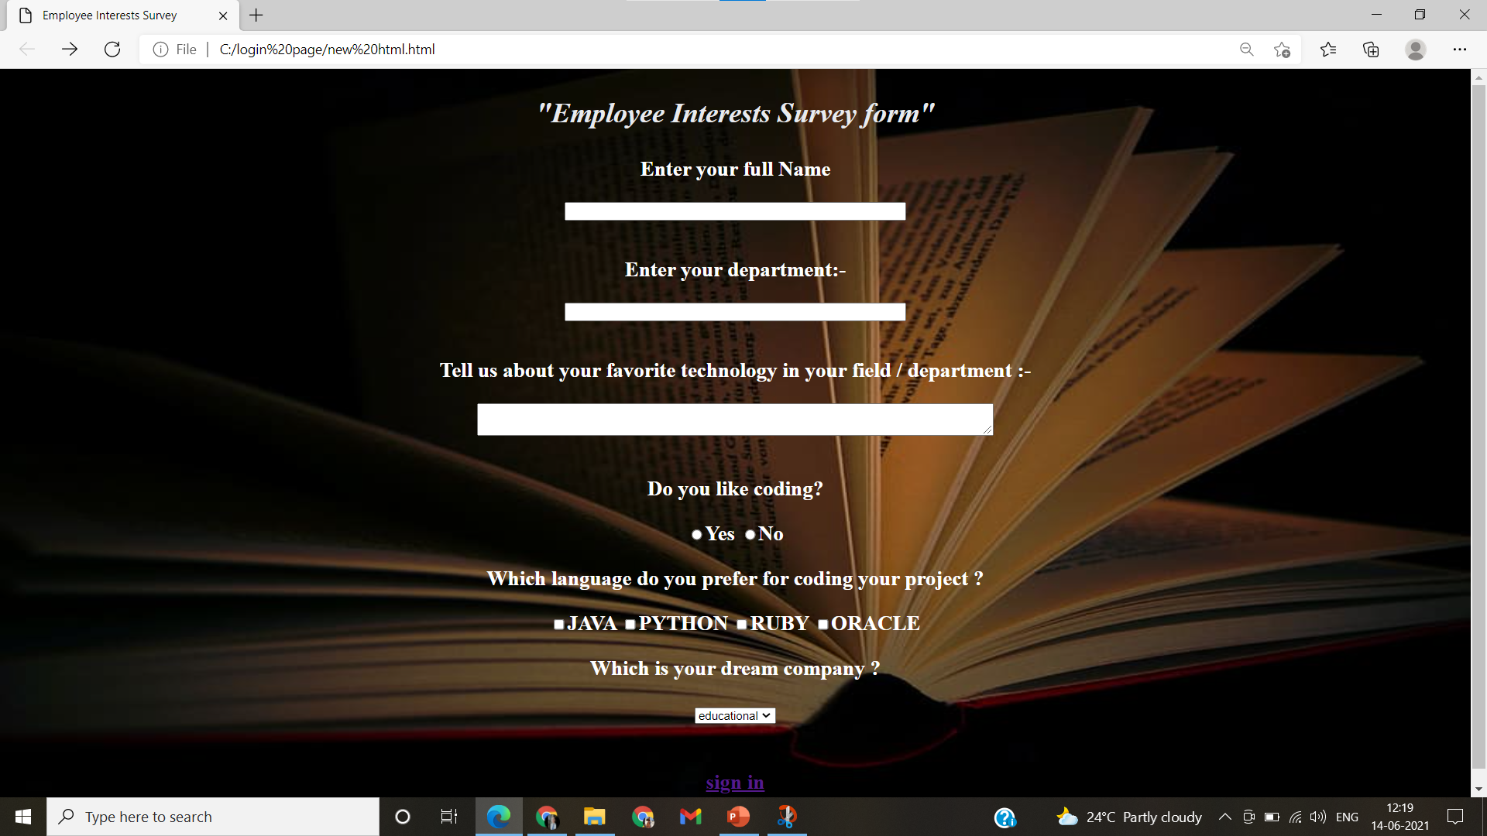
Webpage on employ survey form
S. B. Jain Institute of Technology Management and research

Slide 5
System Design: Flowchart
start
Enter your name
Enter your department
Tell me about your favorite technology
Do you like coding ? ( yes/no)
Which coding language do you prefer ? ( java , python , etc)
Your dream company ( google , Microsoft , etc )
Sign in
End
S. B. Jain Institute of Technology Management and research
5

Slide 6
Technology Used
Front End:
HTML5 , CSS
IDE: VS-CODE
S. B. Jain Institute of Technology Management and research
6

Slide 7
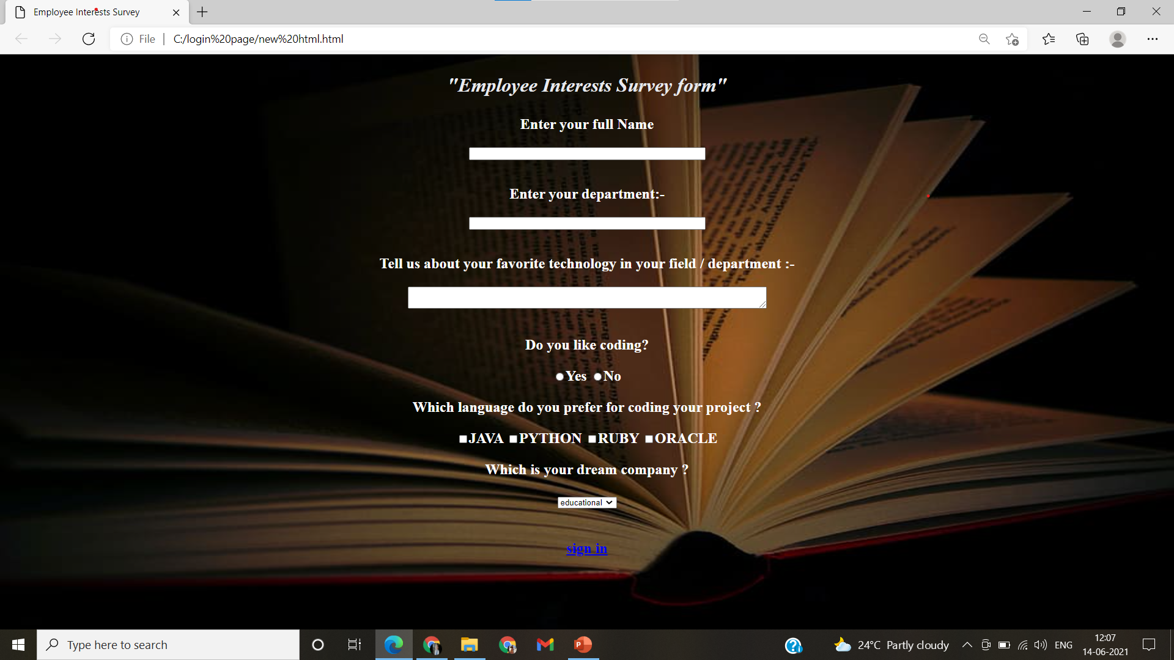
Testing Report
S. B. Jain Institute of Technology Management and research
7

Slide 8
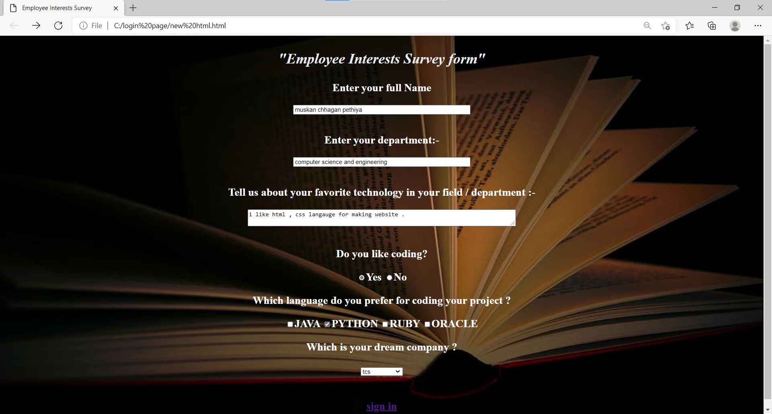
S. B. Jain Institute of Technology Management and research

Slide 9

S. B. Jain Institute of Technology Management and research

Slide 10
Advantages
Employee surveys offer several benefits that include:
Improving morale.
Opening lines of communication.
Providing new ideas that can improve the business.
Encouraging honest feedback that can help managers make decisions and be more aware of problems.
Employee performance, as evaluated by team members and managers, can be evaluated continually. Every improvement tracked can be appreciated, and every reported flaw can be worked on.
Employee surveys will give organization opportunities to focus on aspects such as workplace culture, attracting new employees, retaining the current ones, and constantly focusing on keeping employees content.
Streamline communication with employees so that they do not shy away from sharing their issues with an organization’s management
S. B. Jain Institute of Technology Management and research
10

Slide 11
Conclusion
Hence I conclude here that ,
Employ survey form Also known as employee morale survey, this survey is used to gather opinions that the management and HR can use to build a positive environment for the employees. This can be done by understanding multiple employee perspectives, such as:
Assessment of the human resource department
Contentment in regards to the salary and other perks
Overall job satisfaction
Reasons to stay or leave the job
Assessment of company policies
S. B. Jain Institute of Technology Management and research
11

Slide 12
References
https://www.w3schools.com/html/
https://www.w3schools.com/css/
https://www.javatpoint.com/css-tutorial
https://www.javatpoint.com/html-tutorial
S. B. Jain Institute of Technology Management and research

Slide 13
Thank You

